Slide 1
Human Activity Recognition
Muhammad Saad Uddin
IBM Advance Data Science Capstone

Slide 2
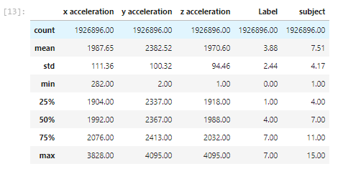
Data Set
This data set was taken from UCI Machine Learning Repository. (https://archive.ics.uci.edu/ml/index.php)
The dataset consist of 1.92 million samples in 3 dimensional form taken from 15 participants which capture human activity with 7 Labels.

Slide 3
Use Case
Mobile apps for activity detection of humans and guiding him what to do next for example performing exercise.
Exhibit strong potential for VR/AR apps. For Example recognizing human posture according to scene or game.

Slide 4
Solution
A Jupyter Notebook has been deployed on GitHub.(https://github.com/SaadMuhammad/IBM-Advance-Data-Science-Capstone)
Multiple Model solution has been setup for both supervised and deep learning

Slide 5
Architectural choices
Jupyter Notebook
GitHub
UCI Data Repository
IBM Watson

Slide 6
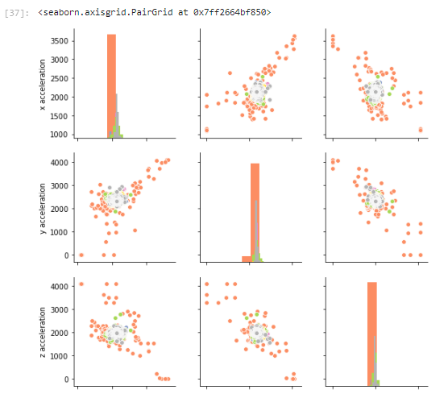
Data quality assessment
The Data is highly skewed. Some Dimensions have even minimum value at 1 or 2 when mean is around 2000

Slide 7
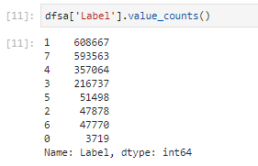
Data quality assessment
A wrong Label (Label 0) is found in the dataset

Slide 8
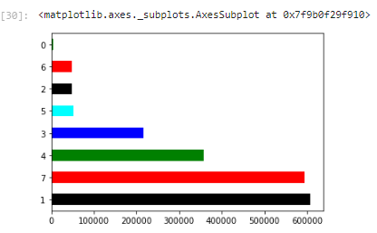
Data quality assessment
Imbalance in Label types counts. Some labels have very few observations compared to other. Opening Window for Bias.

Slide 9
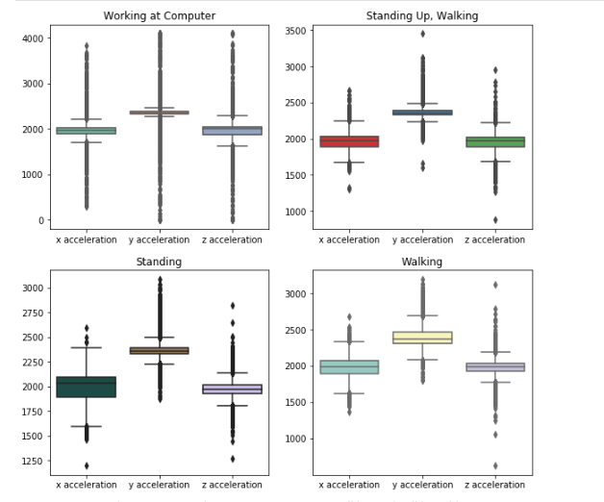
Data pre-processing
Box Plot Visualization for Outliers

Slide 10
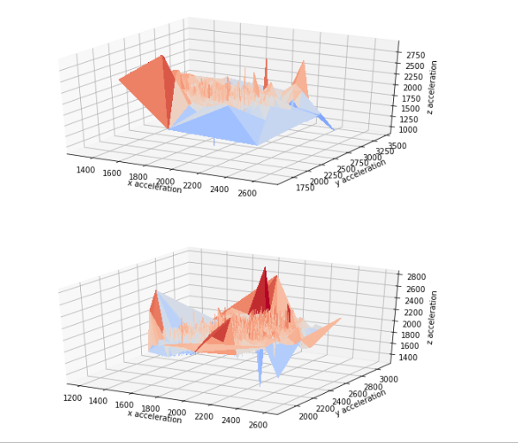
Data pre-processing
Scatter and 3D Plots for x,y & z dimensions to check distribution of data

Slide 11
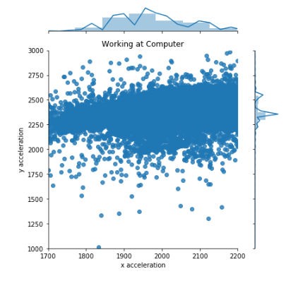
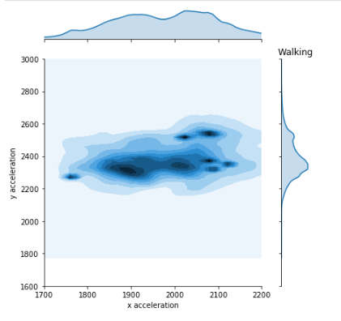
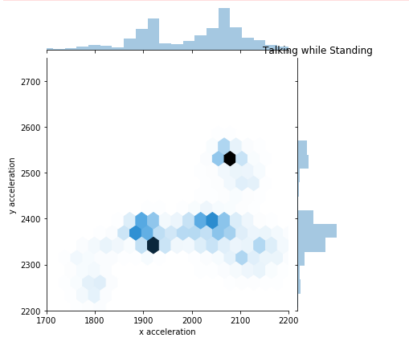
Data pre-processing
Facet Grids to identify Label and subject wise unique traits

Slide 12
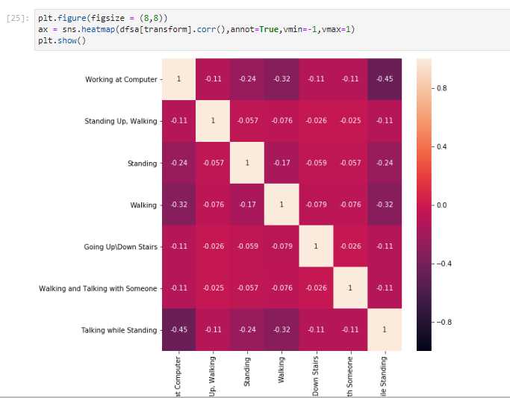
Data pre-processing

Slide 13
Feature engineering
Label ‘0’ was dropped, since it was noise in the information set
Data was scaled using
* MinMax Scalar
* Power Transformer

Slide 14
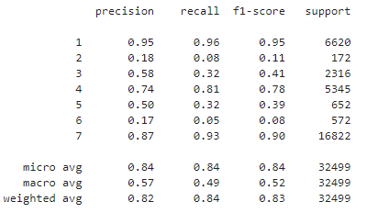
Model performance indicators
Accuracy was the metrics of choice to gauge performance of Models
Confusion Matrix is also employed to view precision, recall, f1 scores and visuals of True and Predicted Labels.

Slide 15
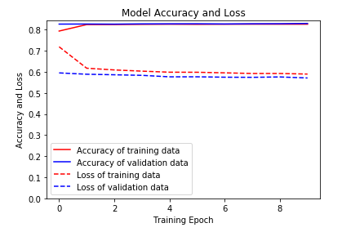
Model performance indicators

Slide 16
Model algorithm
From Supervised Learning XGBoost Classifier was selected
From Deep Learning Keras Sequential was Selected
Hyper Parameters was tuned for Supervised algorithm

Slide 17
Result
Achieved 84.20% Accuracy on unseen data with XGBoost Classifier Model
Achieved 83% Accuracy on test data with Keras Model

Slide 18
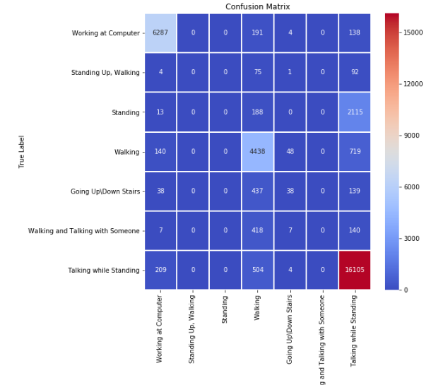
Result

Slide 19
Conclusion
This model can be further improved by adding new features like time period and frequency of each activity or by adding more sensors points
Also a deep learning model with more layers or further tuned XGB or LightGBM model can provide better accuracy

Slide 20
Thank You

